Slide 1


Rolling Bridges!
Activity produced by the Royal Academy of Engineering

Slide 2

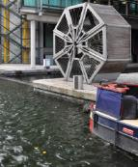
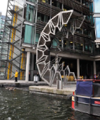
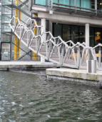
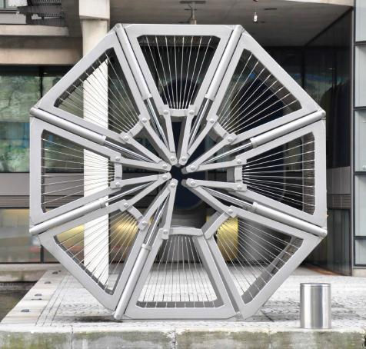
Rolling Bridges
The photographs show a special bridge designed by Thomas Heatherwick. Thomas is a British designer who created the Cauldron at the London Olympics and the new Routemaster bus in London.
He used a lot of mathematics and engineering to develop all these things. But how did he make the bridge and what mathematics did he use? Follow the activities below to find out how.

Slide 3
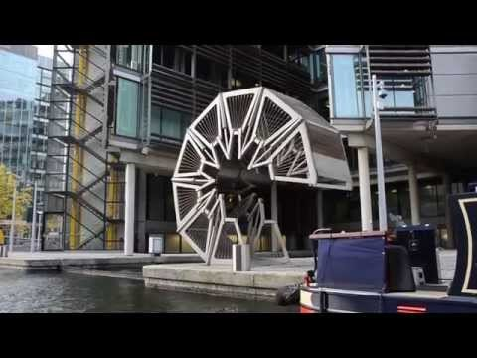

Slide 4
Warm Up!
Can you build your own rolling bridge?

Slide 5

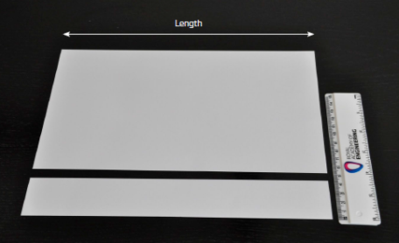
Step 1
In your groups, take a sheet of A4 card and divide it into five equal strips cut lengthways.
To do this you will need to measure the total width of the card in centimetres (cm) and divide by 5. What is the width of each strip?
You should now have
1 strip each with one
left over!

Slide 6


Step 2
Take your strip of card and measure its length (L). Give your answer in centimetres (cm) to one decimal place.
Next, divide the length of paper into 6 sections and mark with a line.

Slide 7

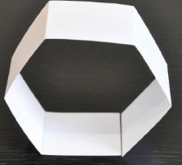
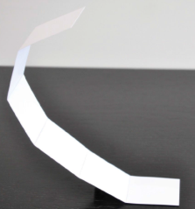
Step 3
Fold down each line to make your rolling bridge!
What shape is this polygon?
Can you see how your polygon rolls and unrolls like Thomas Heatherwick’s bridge?

Slide 8



Step 4
You can imagine the polygon has a circle around it. We can estimate the diameter of the circle that the polygon would fit inside.
The diameter is the name for a straight line that goes from one side of a circle to another passing through the centre point. Estimate the diameter (D) of the circle around your polygon by measuring the distance between two points going through the centre.
Diameter

Slide 9
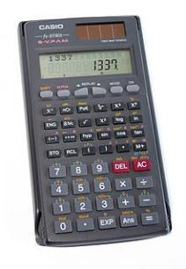
Step 5
Using a calculator, divide the length L (from step 2) by the diameter D (from step 4).

Slide 10
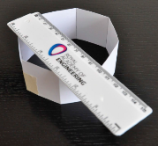
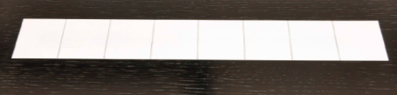
Let’s build another roll-up bridge!
Take a new strip of paper and repeat steps 1-6 for an eight-sided polygon, like the one in the pictures below.
Make sure you write down your answers and show your workings.
If you have time, repeat steps 1–6 again for a ten-sided polygon.
You should now have answers for a six-sided, eight-sided and possibly ten-sided polygon. Do you notice anything about your answers?
Write down what you notice.

Slide 11
Pi (π)
If you did this carefully for a circle rather than a polygon, you would get an answer around 3.1 on your calculator. If you tried lots and lots of circles of different sizes you would find that the answer is always around 3.1 which seems strange. But what you have discovered is that if you divide the length around the edge of any circle (the circumference of the circle) by the diameter then you always get the same number. This number has so many decimal places that your calculator screen could not show them all. In fact, it has infinite decimal places. The number also has a special symbol (a Greek letter) so that we don’t need to write lots of decimal places. The symbol is written like this π.

Slide 12
Pi (π)
The number π is the ratio of a circle's circumference to its diameter.
Action: Copy this Greek letter into your workbook.
The number π to six decimal places is 3.141592 but most people just remember pi to two decimal places.
Action: What is pi to two decimal places? Write down your answer.
Challenge!
How many decimal places can you remember pi to?

Slide 13
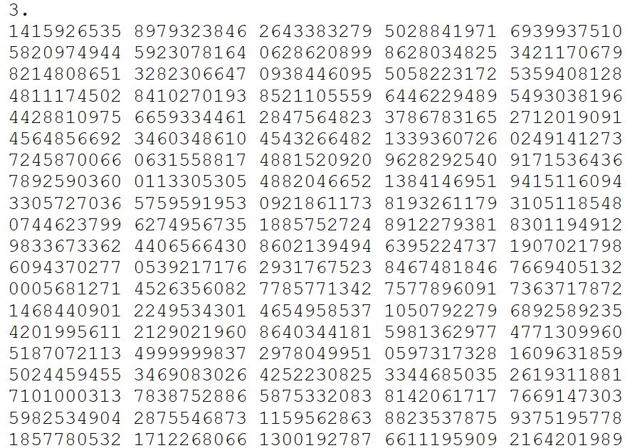

Slide 14


Guinness World Record
The record for memorising Pi was achieved by Chao Lu (China) who recited Pi from memory to 67,890 places, at the Northwest A&F University, Shaanxi province, China, on 20 November 2005. Chao Lu, a chemistry student, attempted the record after practising for 4 years. The attempt lasted 24 hrs 4 min and was recorded on 26 video tapes. News reports from CCTV (China Central Television) and from Yangling TV submitted with the claim. The attempt was witnessed by 8 officials, Maths professors of the NWAFU and 20 students to assist the witnesses.

Slide 15
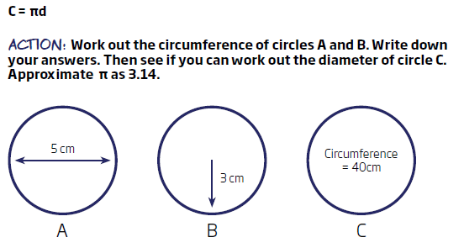
Using Pi

Slide 16
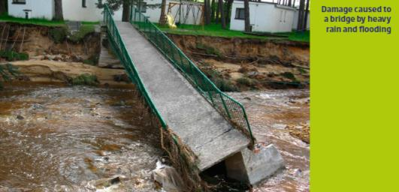
Engineering Challenge!
Emergency! After the heavy rains, there has been a flood in Cumbria in Northern England. The overflowing river has torn down one of the bridges in the town of Keswick in the Lake District.

Slide 17
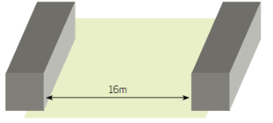
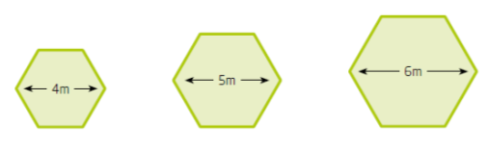
Engineering Challenge!
Your company makes roll-up bridges that can be used after emergencies to create temporary river crossings.
Your challenge is to work out which roll-up bridge below would be most suitable for the emergency crossing in Keswick.
Use your knowledge of the circumference and diameter of circles and π to calculate the answer.

Slide 18
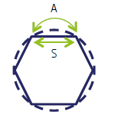
Extension Activity
The bridges you made are not circles. They are polygons.
This means that each segment length S is not quite as long as the length A shown in this picture below. We call this length of a part of a circle’s circumference, the arc length A.
How can we calculate the difference between A and S?

Slide 19
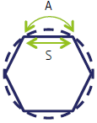
Extension Activity
Step 1
Start with the six-sided polygon. You calculated the value of S for the six-sided polygon earlier in Activity
What is the length of S for the six-sided polygon?
Step 2
Calculate the circumference of the circle using the diameter and π. You estimated the diameter earlier in Activity 1. How do you find the arc length A for one segment?
Step 3
How much bigger is the arc than the segment?
Step 4
Repeat the steps above for the eight-sided polygon.

